Slide 1

Creating Machine Learning Dataset

Slide 2
Part - 1
Detect Letters in Image

Slide 3
AGENDA OF THE VIDEO
Most Common Problem every data scientist face.
Creating a system which can recognise any textual information.
Detecting Letters in an Image
Basics of “open cv” library in python
Reading an Image
Writing an Image
Converting the color to GrayScale
Thresholding the Image
Contour Detection
Drawing Rectangle around detected contours
Pseudocode for letter detection in image.
What you can do from here?
What’s next?

Slide 4
Common Problem for data scientists
Okay, I have got a problem statement and I know it can be solved using Machine Learning but where the heck is the data for my problem.
So, one of the most common problem that every data scientist face is the unavailability of data.
Although, there is a data volume like never before these days but to find that right kind of dataset for my particular problem is a challenging task.
So, this sequence of four videos is all about tackling this problem.

Slide 5
Text Recognition System
Let us suppose, I am interested in building a Machine Learning system for recognising the text in a book or maybe some sort of written text but I don’t have the data. So, I have two options…
Drop the Project Idea
Make my own dataset and then build the system: I can divide this whole process in the following four sub process:
Create a system which detect the letter in Image.
Create a system for making training dataset from bunch of my Images.
Train the algorithm to classify the letters.
Using the system to make the predictions.

Slide 6
Detecting Letters in an Image
So, this video is all about the first sub process and in subsequent videos, we will be implementing each system.
How can I detect individual letters in an image?
We will be using one of most popular python library for doing image and video manipulation called Open CV.
If you are not comfortable with it, don’t worry as We are going to go over some of the concepts of CV2.
So, let us get started.

Slide 7

Basics of open cv
Reading an Image:

Slide 8

Basics of open cv
Writing an existing Image:

Slide 9
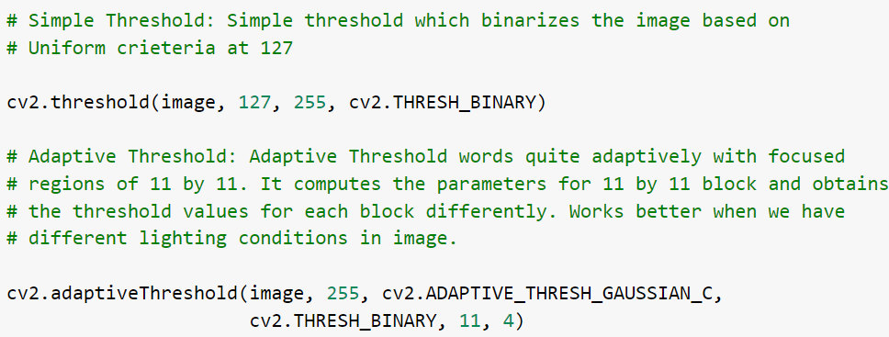
Basics of open cv
3. Thresholding:

Slide 10
Basics of open cv
4. Contour Detection: It can be done quite easily with the findContours function of cv2. It works better when the images have been binarized and blurred as the size of the image reduces by these operations.
It returns a list of contours (which is just a fancy way of saying something in the image which can be considered as an object). Each contour will have a arrays of x y pairs which marks the position of the contour found in the original Image. The image needs to be binary image.

Slide 11
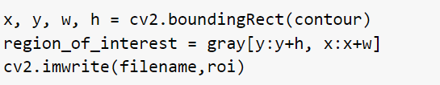
Basics of open cv
After detecting the contours, what we can do is draw a Rectangle around each contour and get the corresponding image saved in our machine.
Once we have the list of contours and a grayscale image, to get the individual image, we can do something like (where roi stands for the region of interest in the gray image):

Slide 12
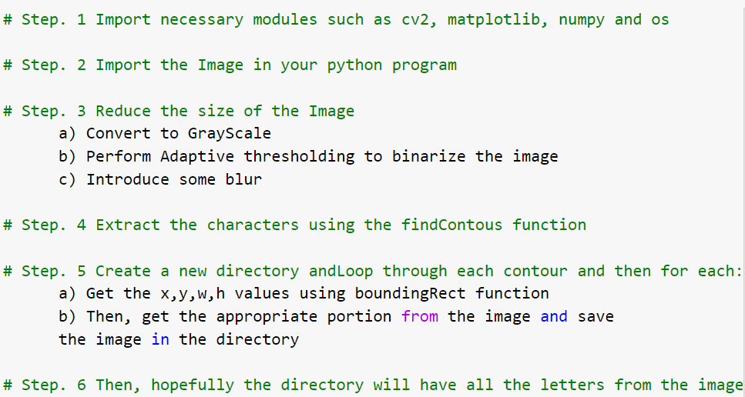
Pseudocode

Slide 13
What you can do now...
You can probably…
Load your own images
And get the letters from those images
The more the images, the better will be as we will have more letters to train our algorithm on.

Slide 14
Next...
In the next part, we will be do the following.
We will collect more letters data from more images
And the using some sort of clustering algorithm and some manual intervention, we will convert the the list of letters images to a nice training data.

